Slide 1
Unit 3
Chapter 5
Lesson 2
Pages 134-137

Slide 2
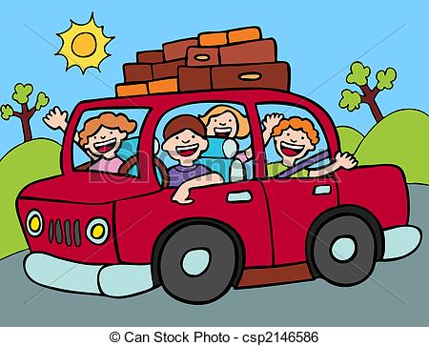
Please Do Now!
Think of a place you would like to go to. Write three lines telling about where you want to go and why you want to go there.
Share with your partner.

Slide 3
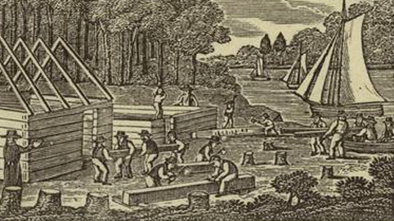
Many people wanted to come to Pennsylvania because of religious freedom and economic opportunities.

Slide 4
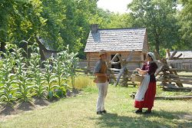
Unfortunately, many who wanted to come to Pennsylvania couldn’t afford the trip or to live here once they arrived.

Slide 5
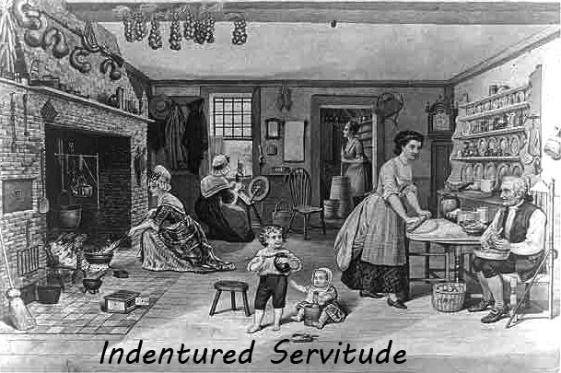
Some people decided to become indentured servants for the chance to come to America.

Slide 6
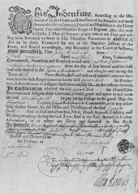
An indentured servant is someone who agreed to work for a person (usually 7 years) in return for a paid trip to America, food, shelter, and clothing when the person arrived.

Slide 7
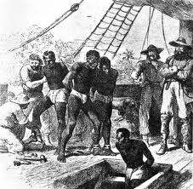
Other people from Africa were kidnapped, forced to come to America, and enslaved. These slaves had no rights, weren’t paid, and usually never got their freedom.

Slide 8
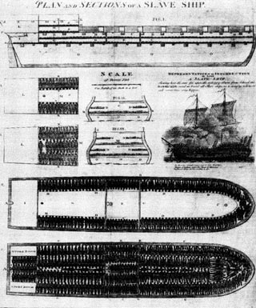
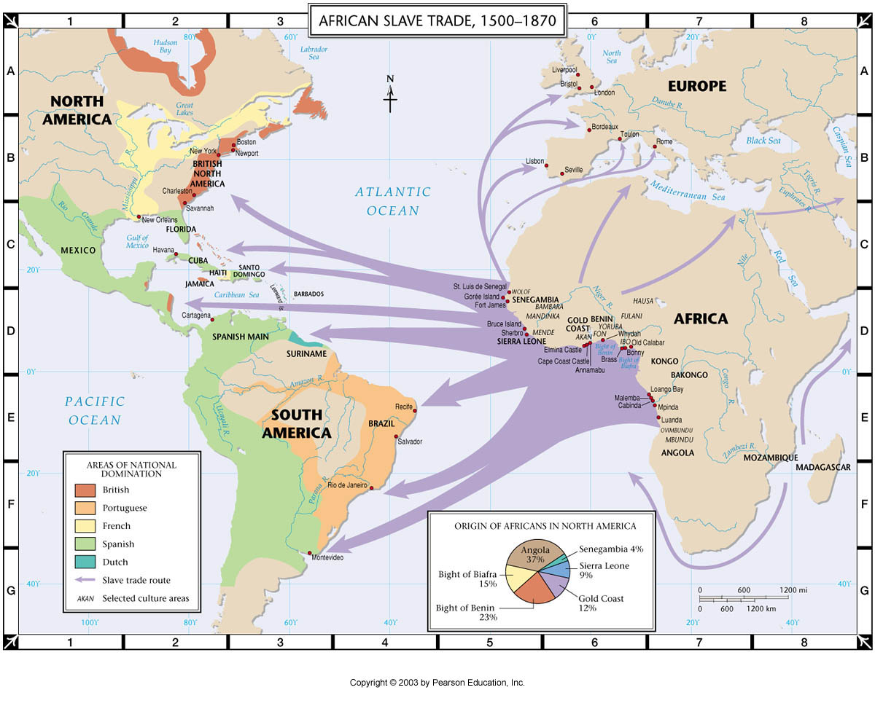
Kidnapped Africans came across the Atlantic Ocean on a route called The Middle Passage. Many died on the terrible journey.

Slide 9

Quote and Comment
Read the quote by former slave, Olauda Equiano, in the box on pg. 135. Write three lines describing your feelings about slavery.
Share with your partner.

Slide 10
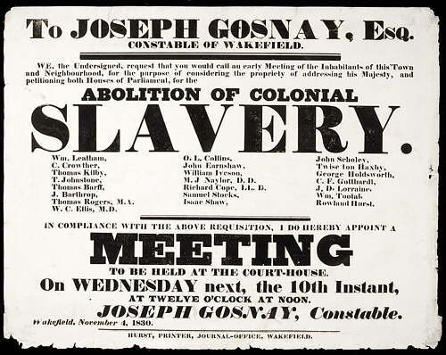
Even though some people living in Pennsylvania owned slaves, many others worked towards abolition, or the ending of slavery.

Slide 11
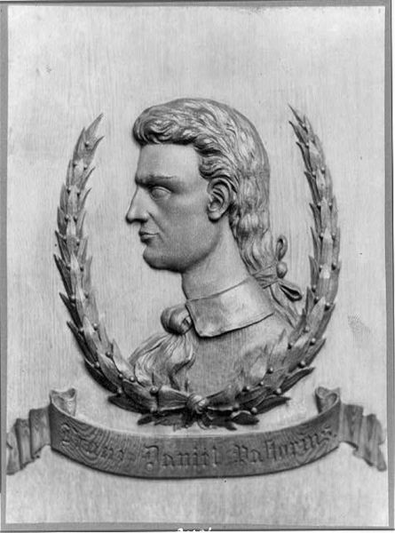
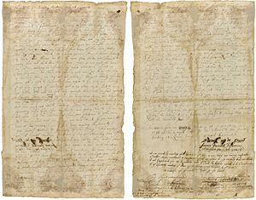
Francis Daniel Pastorius led the Germantown colonists in writing the Germantown Protest in 1688. It was the first antislavery document in the colonies.

Slide 12
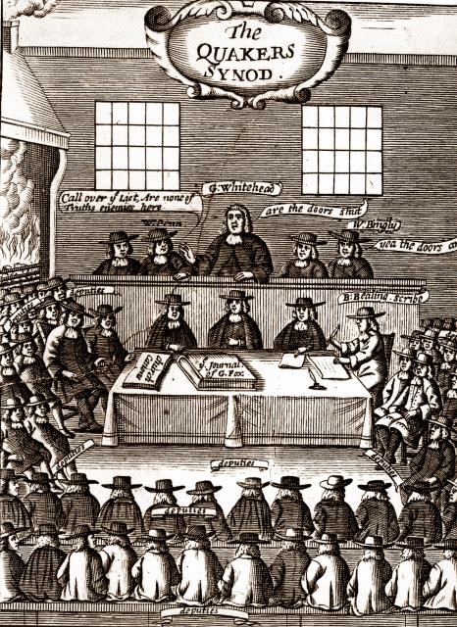
Quakers also worked to abolish slavery. By 1761 the Religious Society of Friends would not accept slave traders as members.

Slide 13
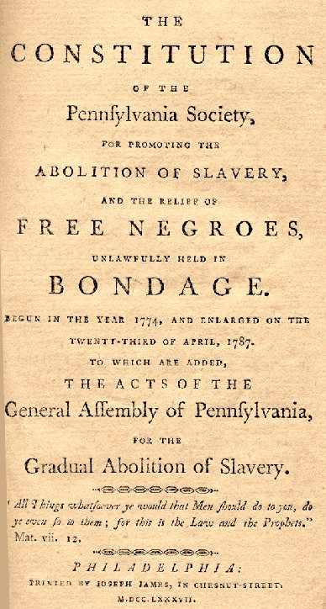
The Pennsylvania Abolition Society was started in 1775 by the Quakers to help people who had been freed from slavery.

Slide 14
3-2-1
3- Write three facts you learned from today’s lesson.
2- Write two questions you have about what you learned today.
1- Write one thing you found interesting in today’s lesson.

